Slide 1
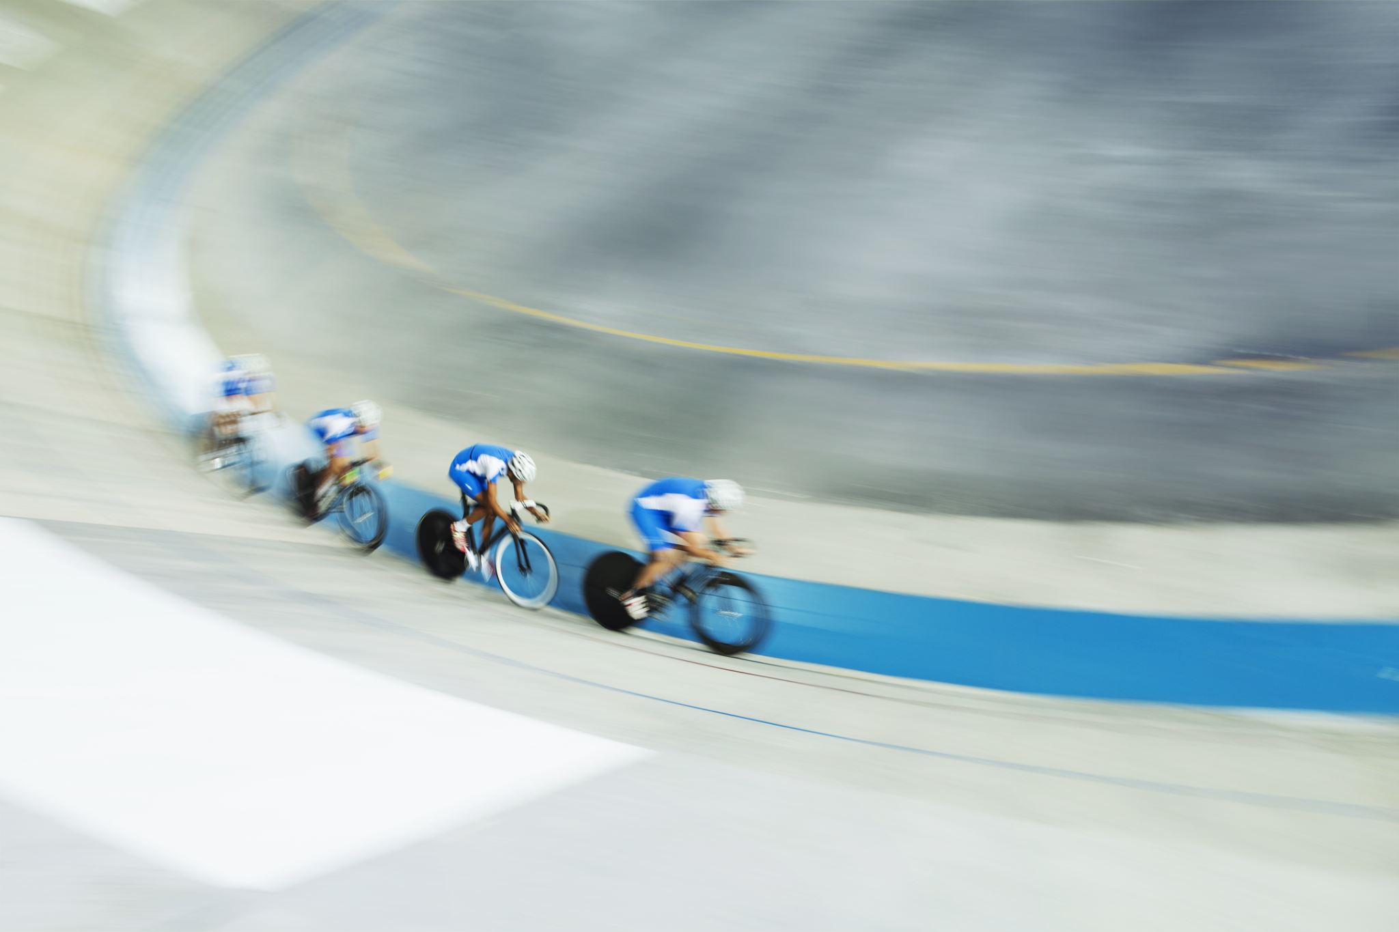
Cyclistic Created By :- Vishnu Sreenivasan Last update :- 25/10/2021

Slide 2
Introduction
Launched in 2016 bike-sharing company
5,824 bicycles,692 stations across Chicago
Reclining bikes, hand tricycles, and cargo bikes
Geo-tracked
Single-ride, full-day ,annual pass

Slide 3
Objective
Design market strategies for converting casual members into annual members.

Slide 4
Business question
How do annual members and casual riders use bikes differently?
Why would casual riders buy Cyclistic annual memberships ?
How can Cyclistic use digital media to influence casual riders to become members?

Slide 5
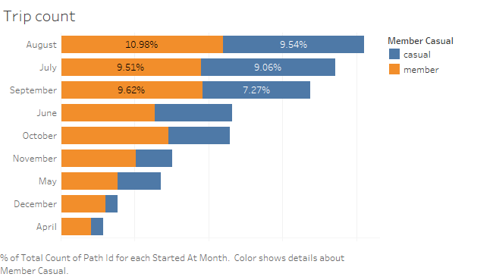
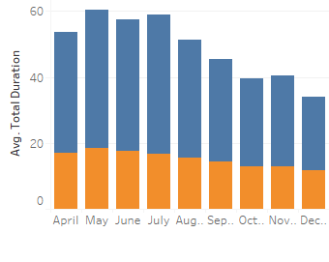
MONTHLY ANALYSIS
50% of rides in July, August, September.
Start of fall season
Avg time for members = 15 –18 mins
Avg time for casual = 36-41 mins

Slide 6
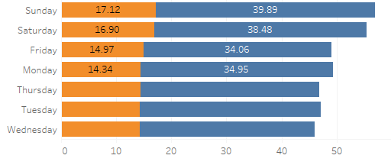
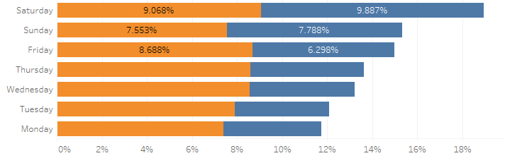
Week day Analysis
Customers prefer to ride mostly on weekends
Riders spend more time on weekends
Rides occur mostly during holidays.
Casual and annual members have almost equal rides

Slide 7
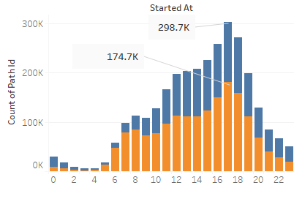
Hour by Analysis
Rides occur between 3pm and 6pm.
Member riders between 5pm and 8pm more compared to casual riders

Slide 8
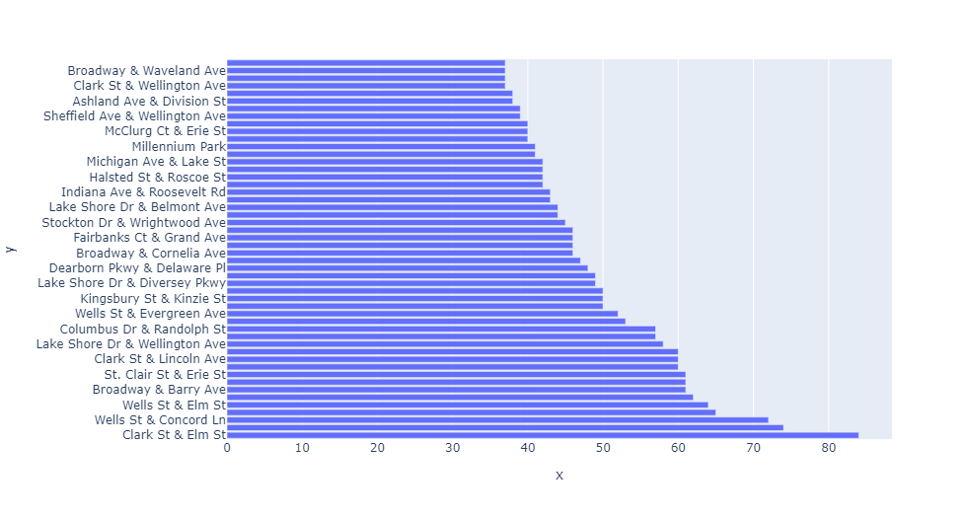
Most active stations
Top 50 most active paths in terms of rides to different stations

Slide 9
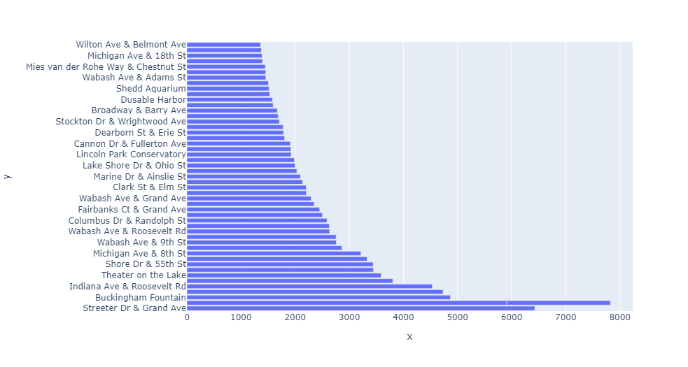
Active stations
Top 50 most active stations in terms of total rides.

Slide 10
Suggesstions
Start advertising campaign during the start of fall season
Target members from the active stations
Provide promotional offers .
Use digital platform for advertisement .
Organize cycling Competitions
Add new features for Interactive sessions with members

Slide 11
Data Cleaning & Transformation
Combined csv.files for April, May, June, July, August, Sept, Oct, Nov and dec.
Removed data points where total duration equal to and below o mins
Removed data points where the duration is more than 1000 mins
Filtered data points for ride count more than 130 rides

Slide 12
Tableau Dashboard
Click here for live dashboard

Slide 13
Questions ?

Slide 14
Thank you

